Slide 1



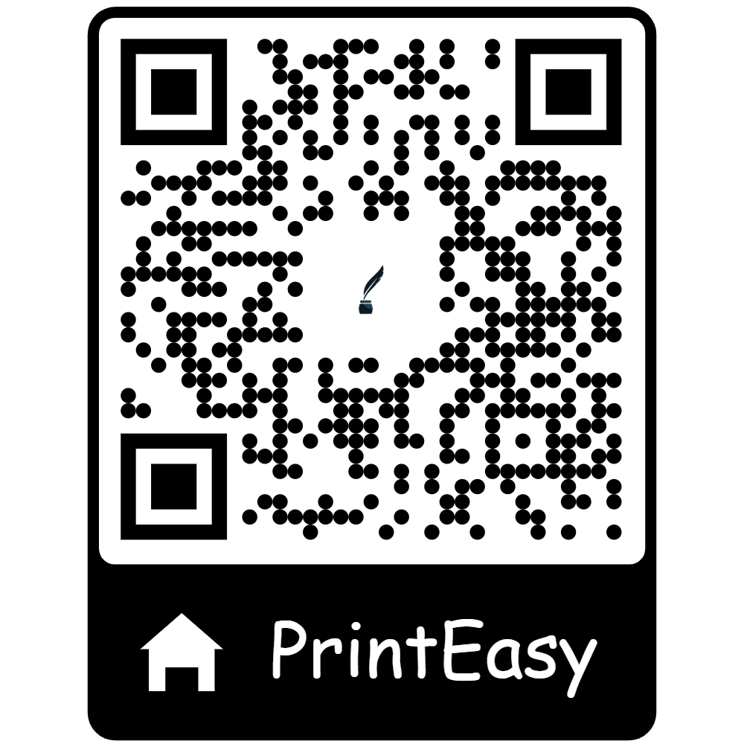

HOME
ABOUT
CONTENT
OTHERS
PRINTEASY:-
SWIFT ENCRYPTED PRINTWORKS & QR SOLUTIONS
BATCH 04
OUR MENTOR:
Mrs.S.Nagajyothi
Asst.Professor
IT-DEPT
G.Gayathri
Lead & Backend DEV
Simam Fouzan
Frontend & UI DEV
Shanthan Kumar
Backend & Testing
wwwprinteasy.com
PAGE 01

Slide 2


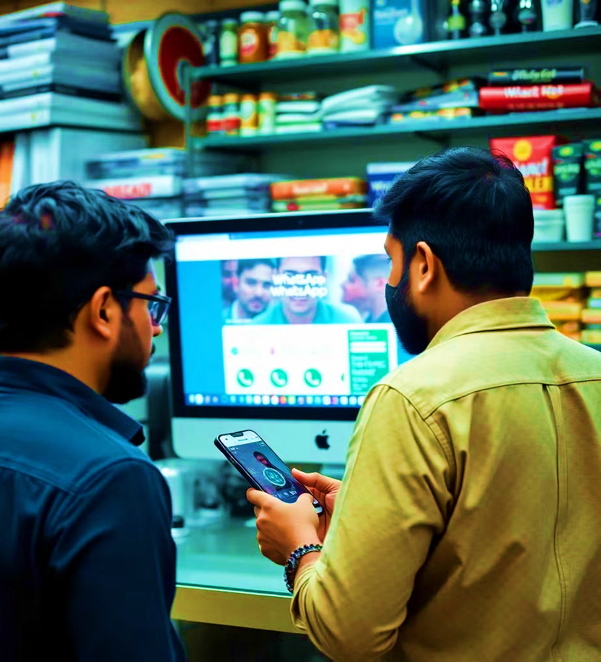
HOME
ABOUT
CONTENT
OTHERS
INTRODUCTION
Have you ever tried printing documents at a printing shop?Every time we needed a photocopy of my doc, we have to mail to the person in the shop or share my number,carry a usb . What if someone at the print shop has access to your file and views it without your permission? what if your personal or confidential data is present on the system after the print job is done? you completely forget about your files once they’re printed and walk away. That’s a real risk. Those files could stay on the printer’s computer for an indefinite period, exposed to anyone who has access to that machine.
www..printeasy.com
PAGE 02

Slide 3

HOME
ABOUT
CONTENT
OTHERS
ABSTRACT
PrintEasy is an innovative website designed to simplify and secure document printing. It eliminates the need for USB drives or email transfers by generating a QR code for uploaded files. Users scan the code at print shops, ensuring a seamless, private, and efficient process that prioritizes data security and user convenience
www.printeasy.com
PAGE 03

Slide 4

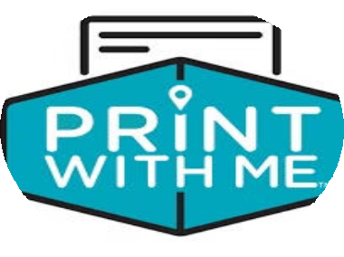

HOME
ABOUT
CONTENT
OTHERS
EXISTING SYSTEMS
Upload documents through Cloud, Bluetooth Wi-Fi
WePrint
EuroSmartz Ltd
Not for public printing shops
PrintWITHME
WithMe, Inc
Location Dependent
Device compatibility issues, lack of support for printing shops
Printershare
Mobile Dynamix
WWW.REALLYGREATSITE.COM
www.printeasy.com
PAGE 04.

Slide 5

Product Overview Infographics
HOME ABOUT CONTENT OTHERS
01
Security & Privacy
WHY PRINTEASY?
Streamlined process
02
03
Reliable
04
Real Word Efficiency
www.printeasy.com
PAGE 05.

Slide 6
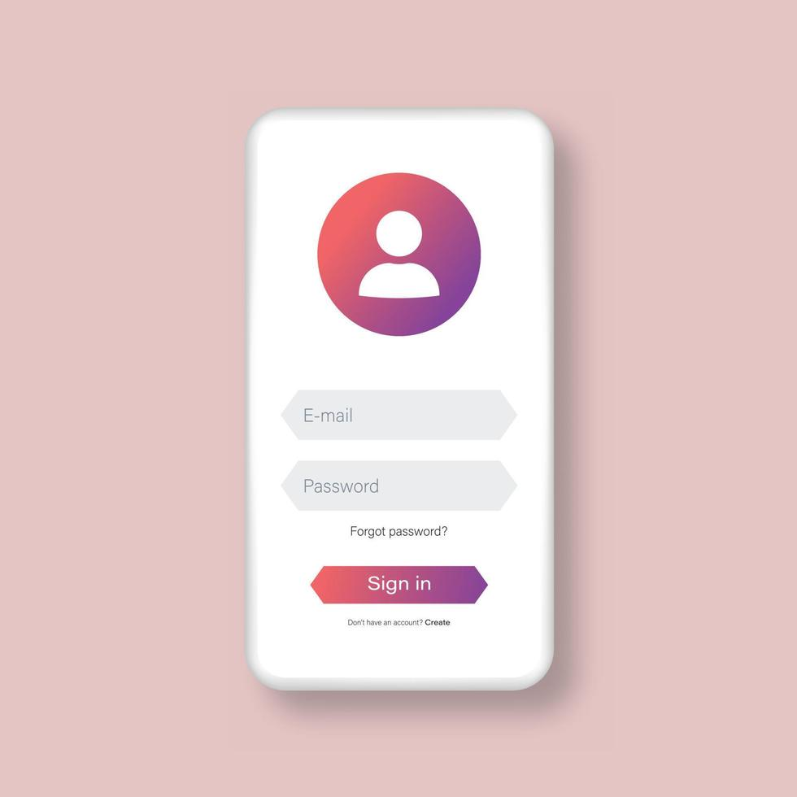
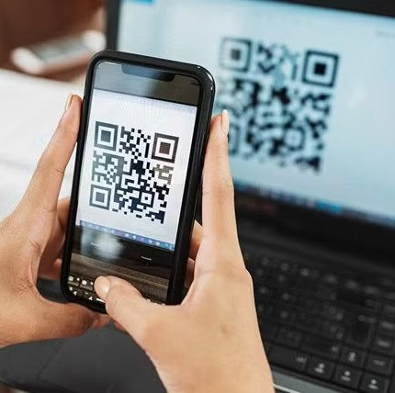
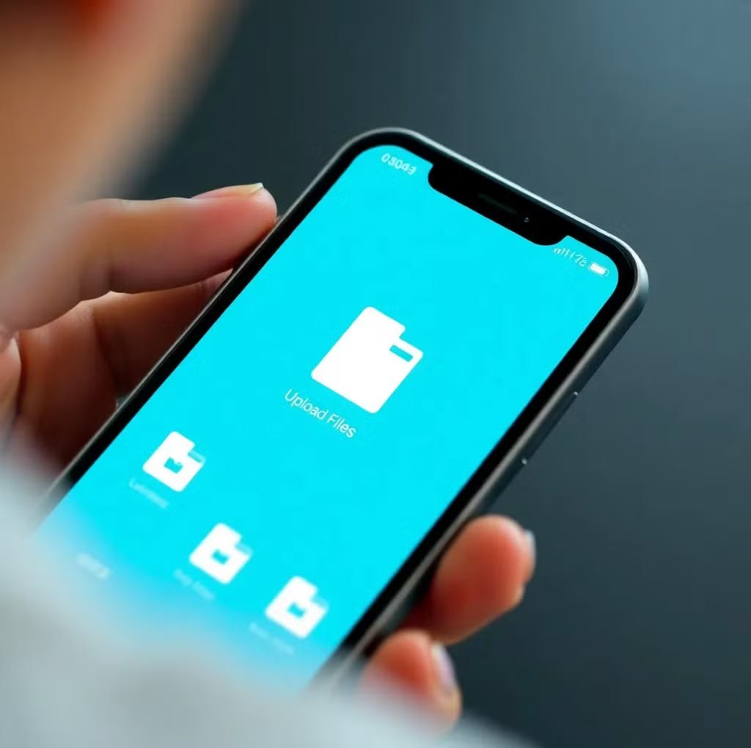
HOME
ABOUT
CONTENT
OTHERS
HOW PRINTEASY WORKS?
STEP-2
Upload your files, documents in the website
STEP-3
STEP 1.
Website interface present on printing shop computer
Sign in to the website on your mobile
PAGE 06
www.printeasy.com

Slide 7
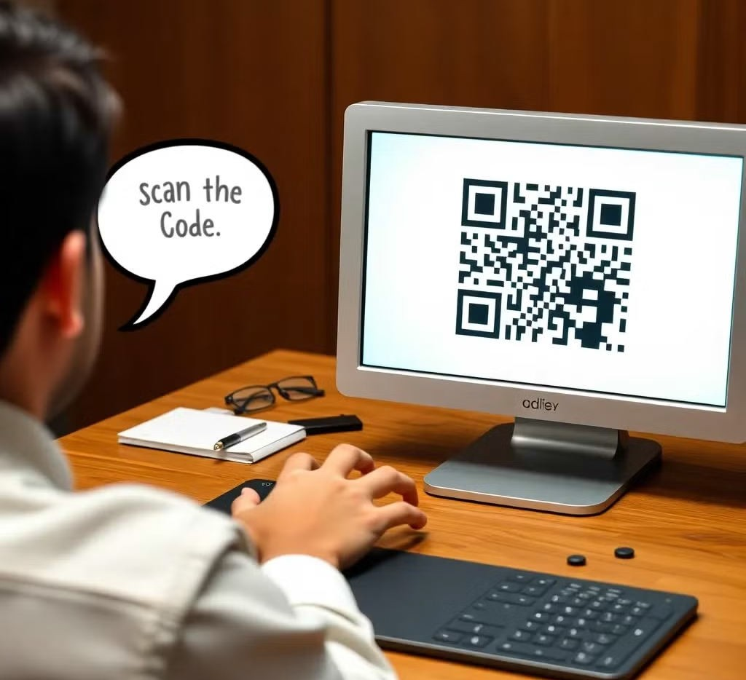
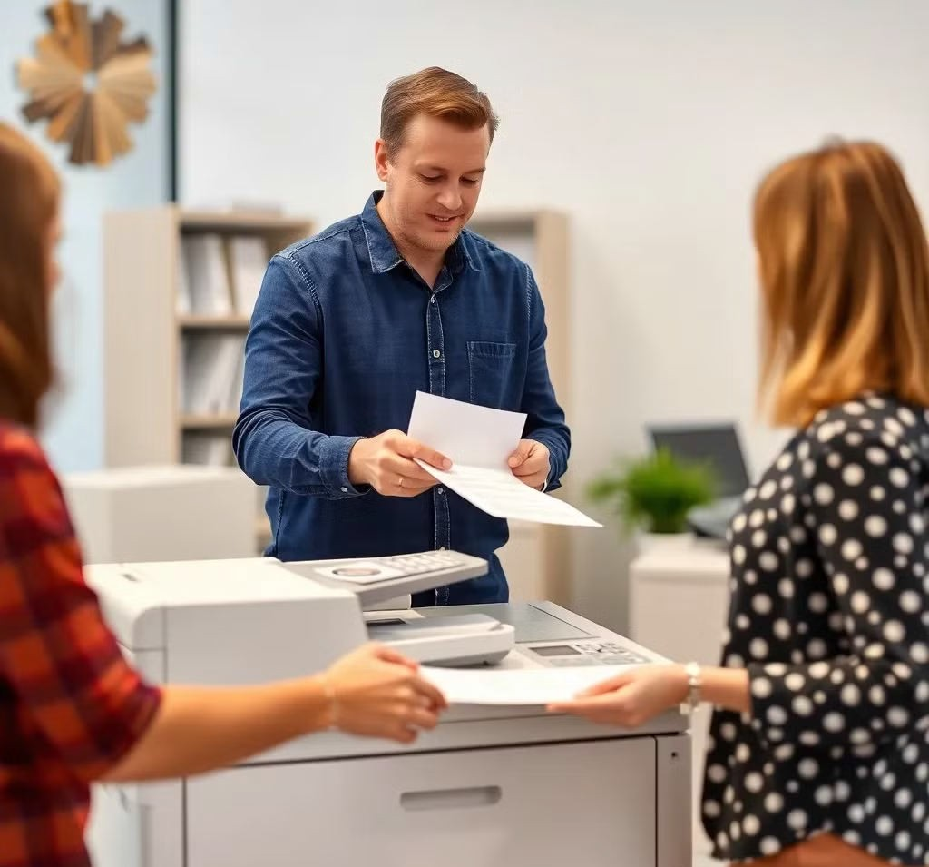
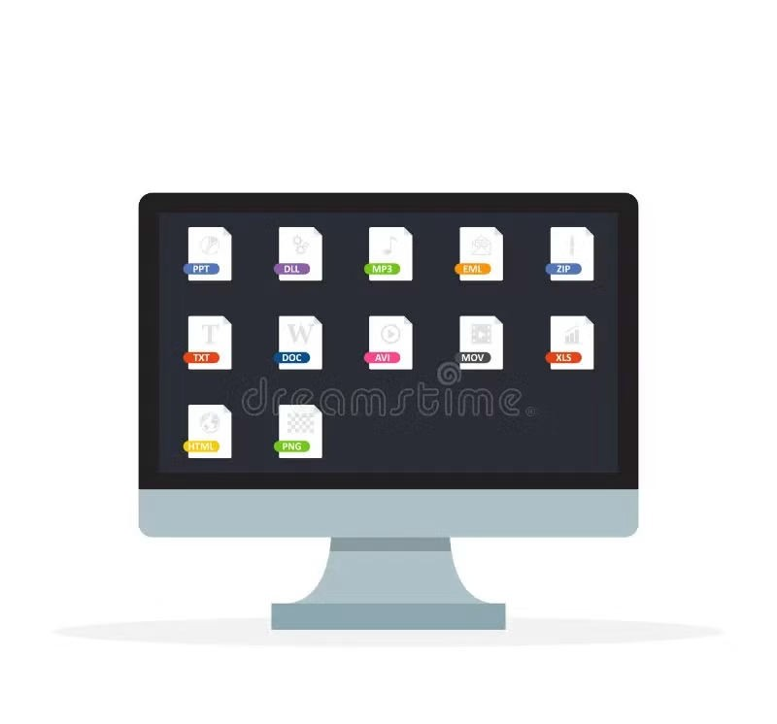
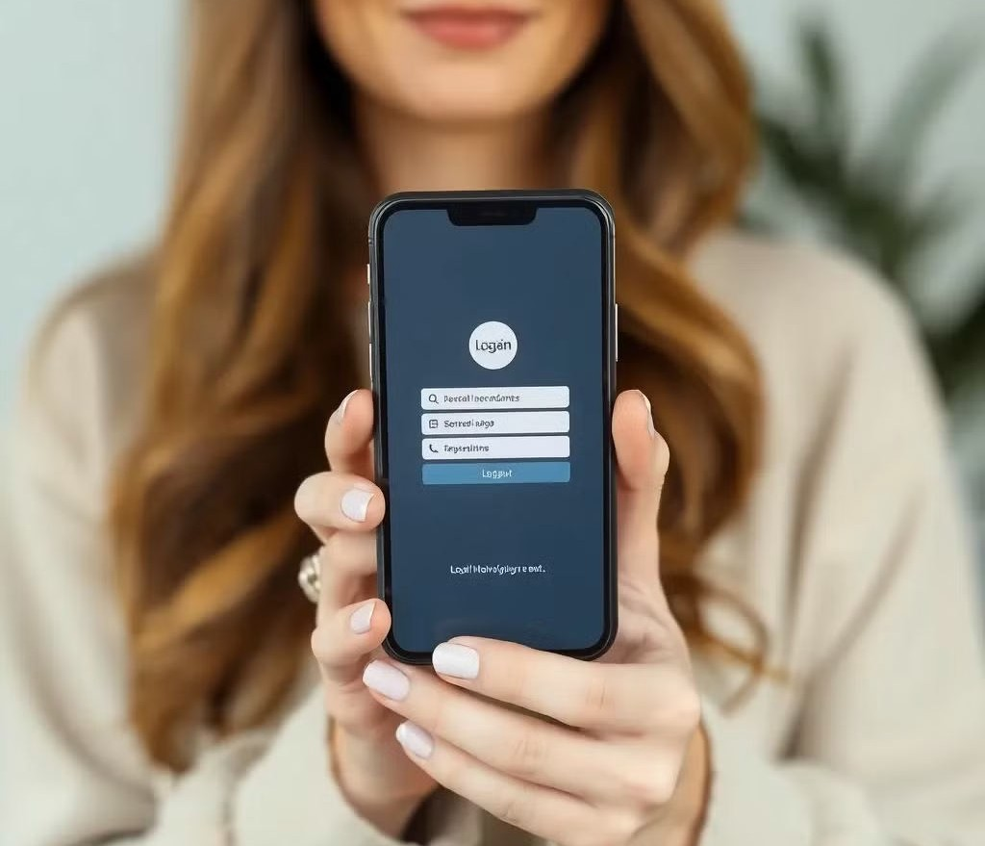
HOME
ABOUT
CONTENT
OTHERS
HOW PRINTEASY WORKS?
STEP-5
After scanning, the documents will appear on the computer
STEP 7
Auto-Deletion of files option
STEP 4
STEP-6
Website Interface present in the printing shop.Scan the QR Code present on the computer by your phone.
Customer can collect there printouts
PAGE 07
www.printeasy.com

Slide 8










HOME
ABOUT
CONTENT
OTHERS
ARCHITECTURE
Crud operations
Bcrypt
MongoDB
Database
QR Generation
Express+node
React
MERN STACK
Backend
frontend
JWT Authentication
Doc upload
File storage
LOGIN/SIGNUP
WWW.REALLYGREATSITE.COM
www.printeasy.com
PAGE 08

Slide 9

HOME
ABOUT
CONTENT
OTHERS
FEATURES
2.Automatic Deletion Of Files
4. Secure Document Handling
1. QR Code Based Printing
3. Encrypted Document Handling
5.Customization of Files
WWW.REALLYGREATSITE.CO
PAGE 07
PAGE 09

Slide 10
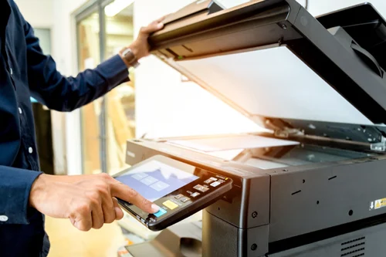
HOME
ABOUT
CONTENT
OTHERS
MARKET OPPORTUNITIES
More than 50,000 printshops in India. Potential market base:Students,Bussiness,freelancers,day to day customers
Service Charge: ₹2 per document printed.
Monthly Users : 10,000 users.
Average Prints per User: 5 documents/month
Revenue: ₹10,00,000/year
WWW.REALLYGREATSITE.COM
www.printeasy.com
PAGE 10

Slide 11



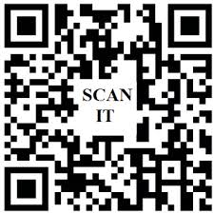

HOME
ABOUT
CONTENT
OTHERS
CONCLUSION
This Website addresses the challenges of traditional printing methods by offering a streamlined, secure, and user-friendly solution.It eliminates the need for physical document handling or interactions with print shop personnel, promoting a contactless experience Users have full control over their document's privacy and security settings, allowing them to decide when to delete files or keep them in the system
.
WWW.REALLYGREATSITE.COM
www.printeasy.com
PAGE 11

Slide 12

Thank you for your time and consideration. We look forward to discuss your queries
Thanking you.
G.Gayathri
Lead & Backend DEV
Simam Fouzan
Frontend & UI DEV
jjj
Shanthan Kumar
Backend & Testing

